Slide 1
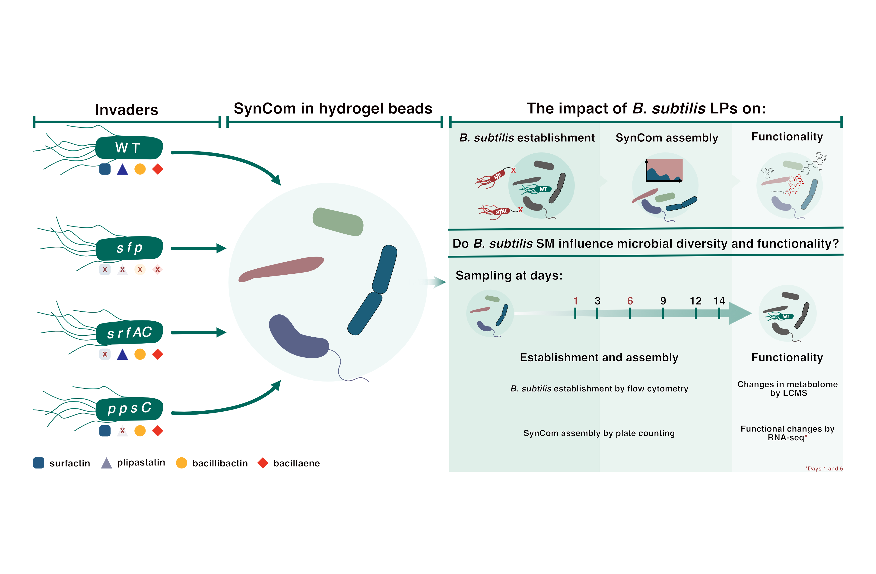
Figure 1 A schematic diagram illustrating the experimental design, and the research question of the main experiments conducted. B. subtilis P5_B1 and its NRP-deficient mutants were inoculated into a 4-member SynCom propagated in the hydrogel bead microcosms.

Slide 2
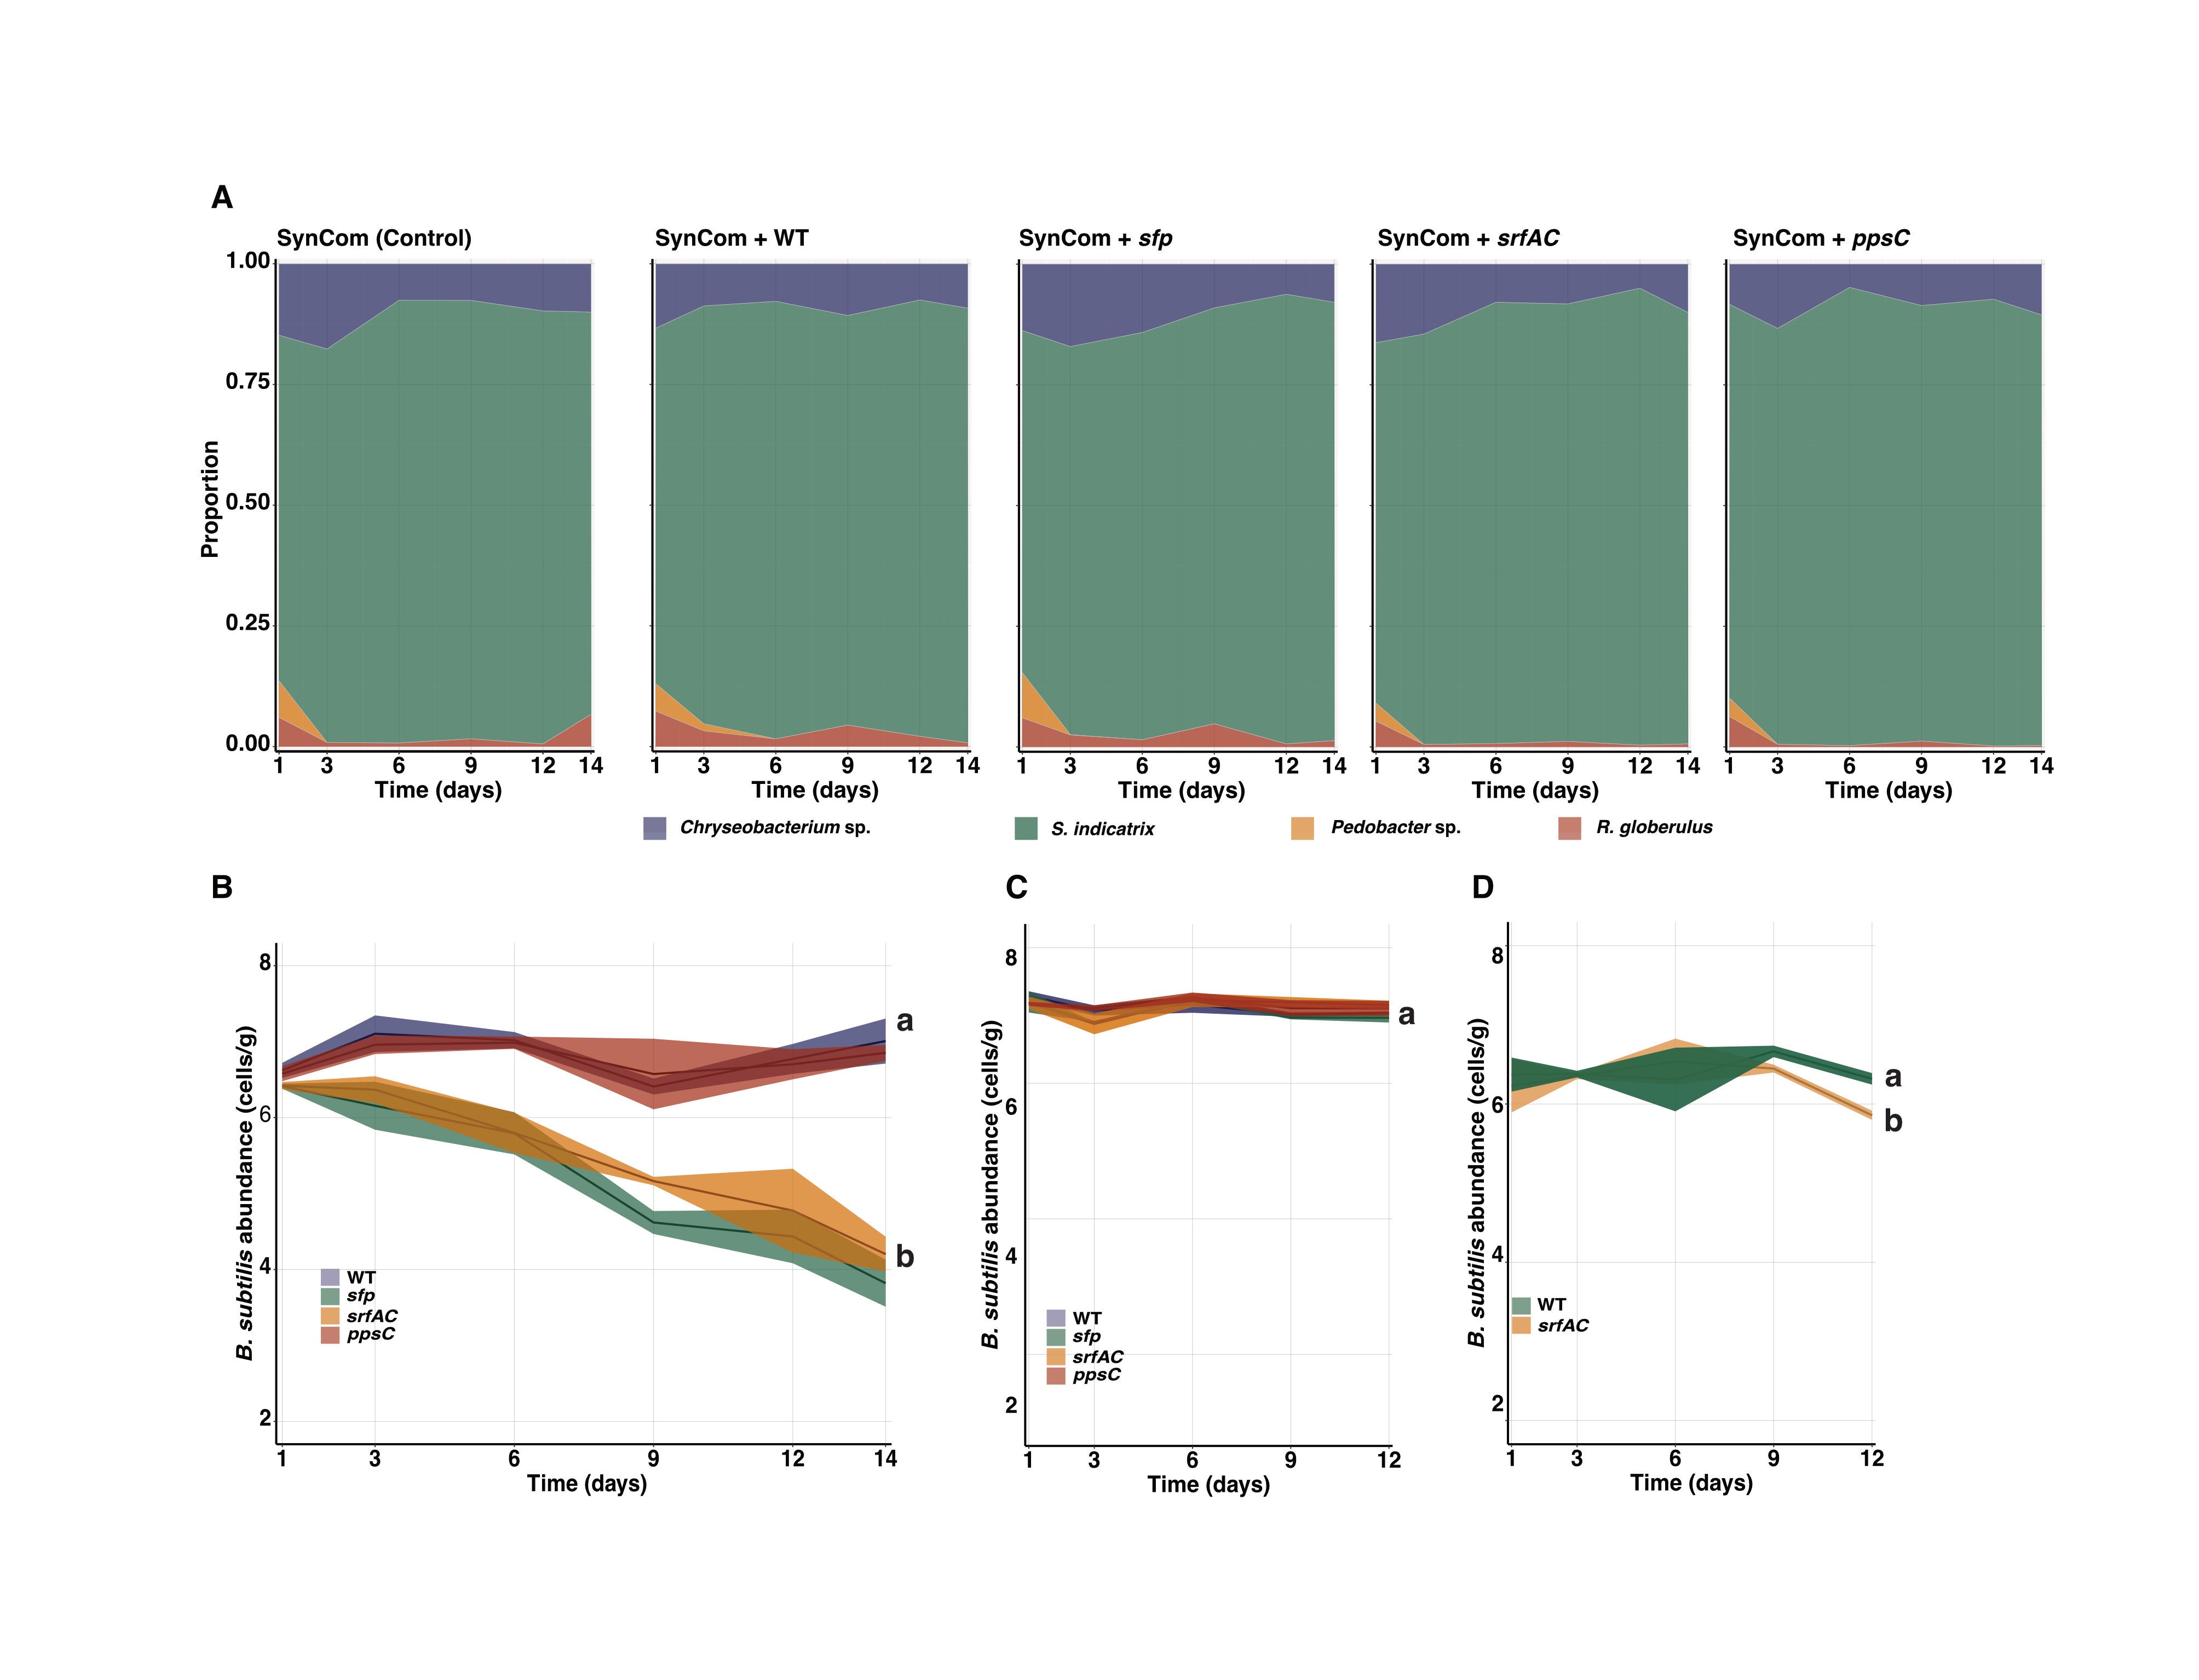
Figure 2 Surfactin production facilitates B. subtilis establishment in a SynCom but does not alter its composition over time in soil-like environment. A set of gfp-labeled B. subtilis strains (Surfactin producers: WT and ppsC, non-producers: sfp and srfAC) were introduced into SynCom and their populations were followed over time to determine the role of LPs in SynCom assembly and their contribution to B. subtilis establishment in that simplified system. (A). SynCom assembly after the different B. subtilis variants were introduced. Members abundances are represented as proportion occupied by each member related to the total biomass in the system. (B) B. subtilis gfp-labelled population dynamics after introduction in the SynCom. Surfactin producers (WT and ppsC) population size remains stable over time while non-producers (sfp and srfAC) sharply decline by the end of the experiments suggesting that surfactin production is crucial for B. subtilis establishment in the SynCom. (C) B. subtilis WT and its derivates mutant growth dynamics when propagated individually in the hydrogel microcosms. The letters represent significant difference among groups at day 14 (one-way ANOVA and Tukey Honest tests). The experiment was conducted independently twice with n=3 in both cases. The data were pooled and analyzed together.

Slide 3
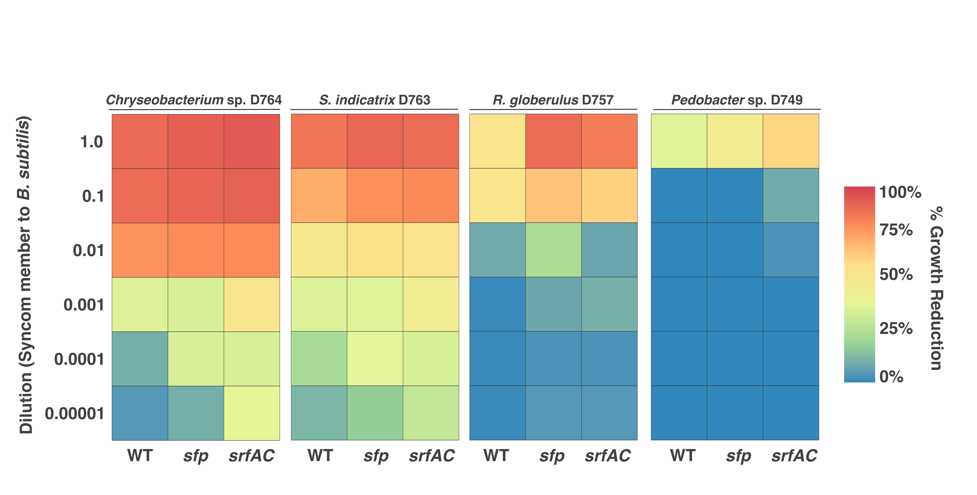
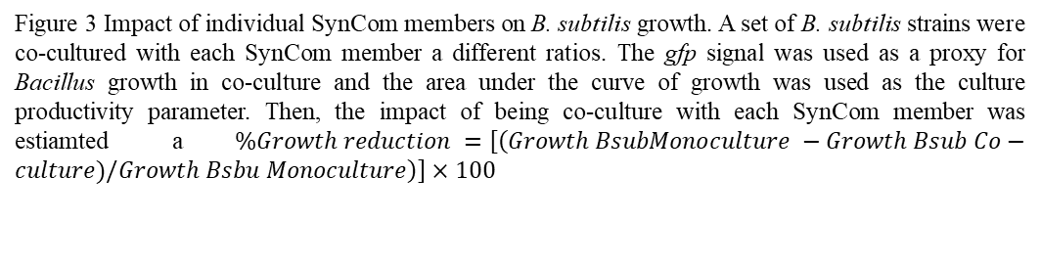
Figure 3 Impact of individual SynCom members on B. subtilis growth. A set of B. subtilis strains were co-cultured with each SynCom member a different ratios. The gfp signal was used as a proxy for Bacillus growth in co-culture and the area under the curve of growth was used as the culture productivity parameter. Then, the impact of being co-culture with each SynCom member was estiamted a$\%Growth reduction =\left[\left(Growth BsubMonoculture −Growth Bsub Co−culture)/Growth Bsbu Monoculture\right)\right]×100$

Slide 4
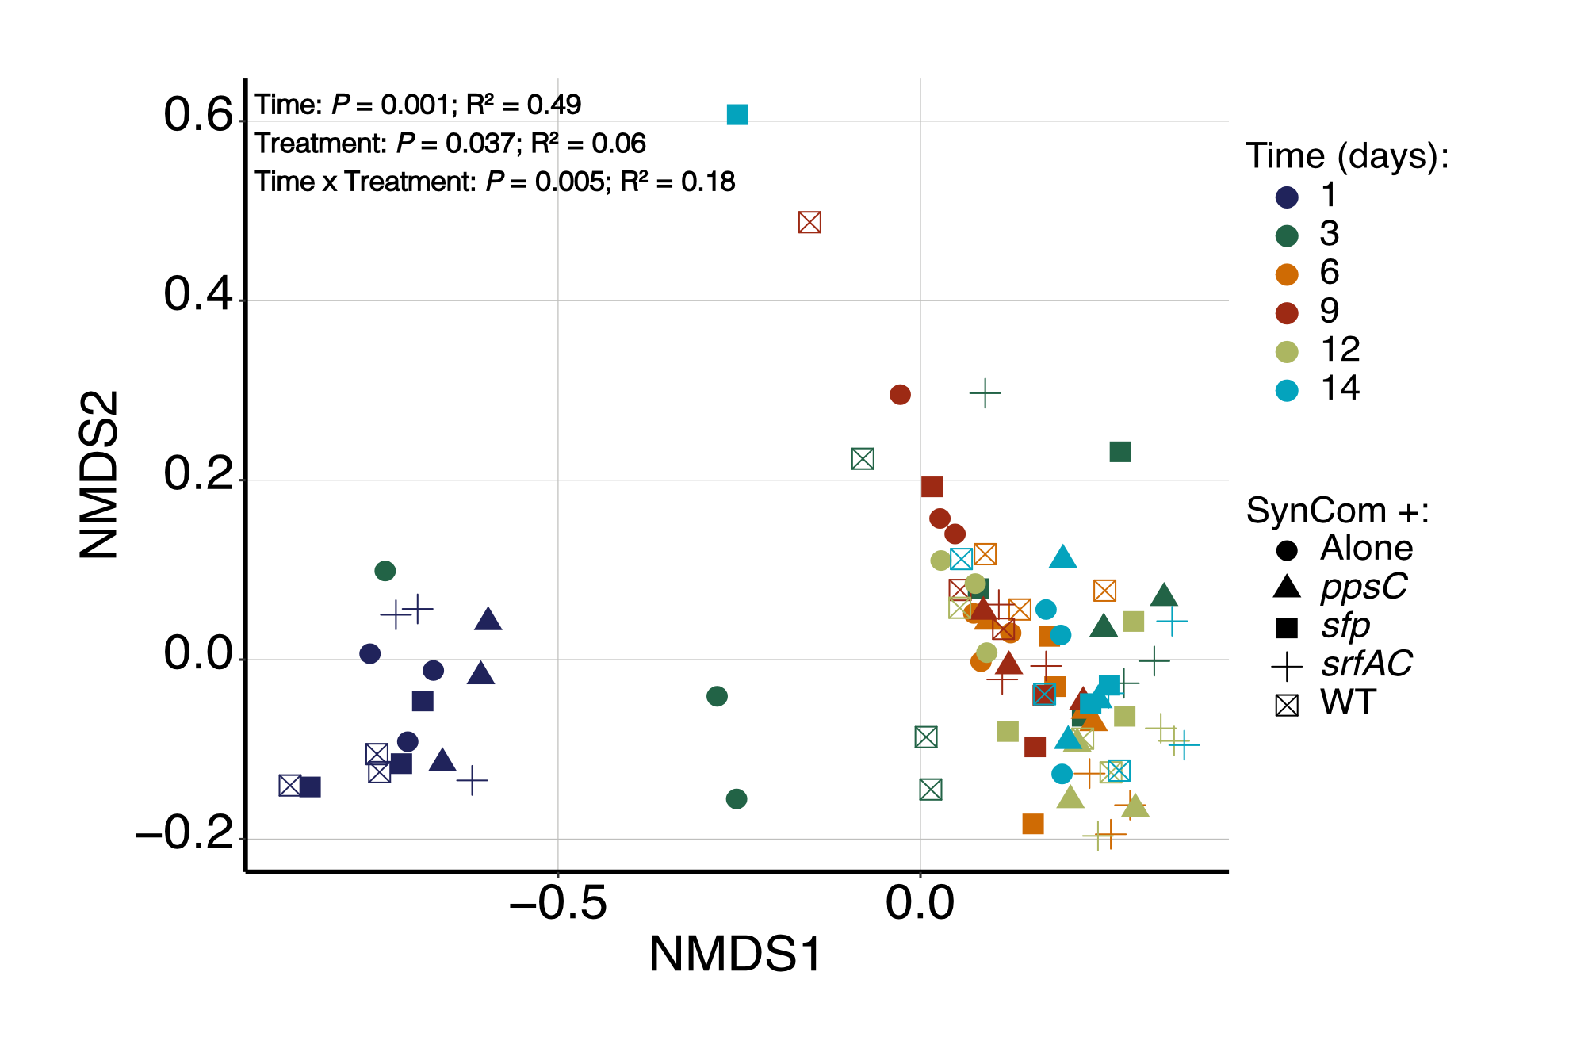
Figure 4 Changes in SynCom compositon upon B. subtilis inoculation. Bray-Curtis distance NMDS ordination plot performed on the CFU data of the SynCom after B. subtilis introduction for comparing the effects of time (colors) and the variant of B. subtilis (shapes) on SynCom composition. The statistical differences were assessed by a PERMANOVA. The P values and R² are reported inset the figure.

Slide 5
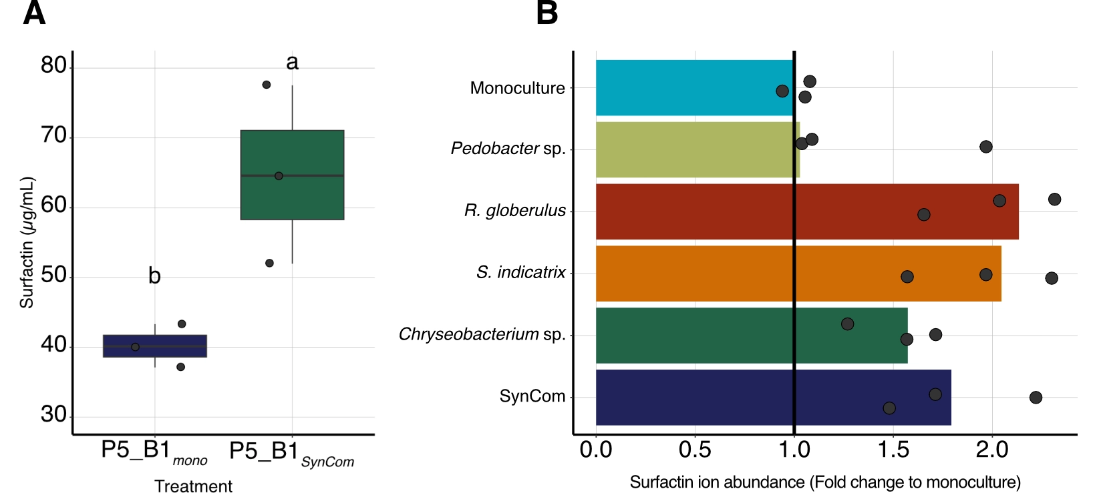
Figure 5. The full SynCom and individual SynCom members induce surfactin production both in the bead system and in liquid culture. (A) Surfactin production in the bead system by P5_B1 increased when co-cultivated with the full SynCom compared to pure B. subtilis monoculture. The concentration was estimated from the last day of sampling in the B. subtilis – SynCom co-cultivation experiment. The letters represent significant differences (t-test, P = 0.00317) (B) Changes in surfactin production when P5_B1 was supplemented with free-cell supernatants obtained from individual SynCom members and the full SynCom in liquid cultures. In both experiments, surfactin production was quantified by UHPLC, and three replicates (n = 3) were performed per treatment.

Slide 6
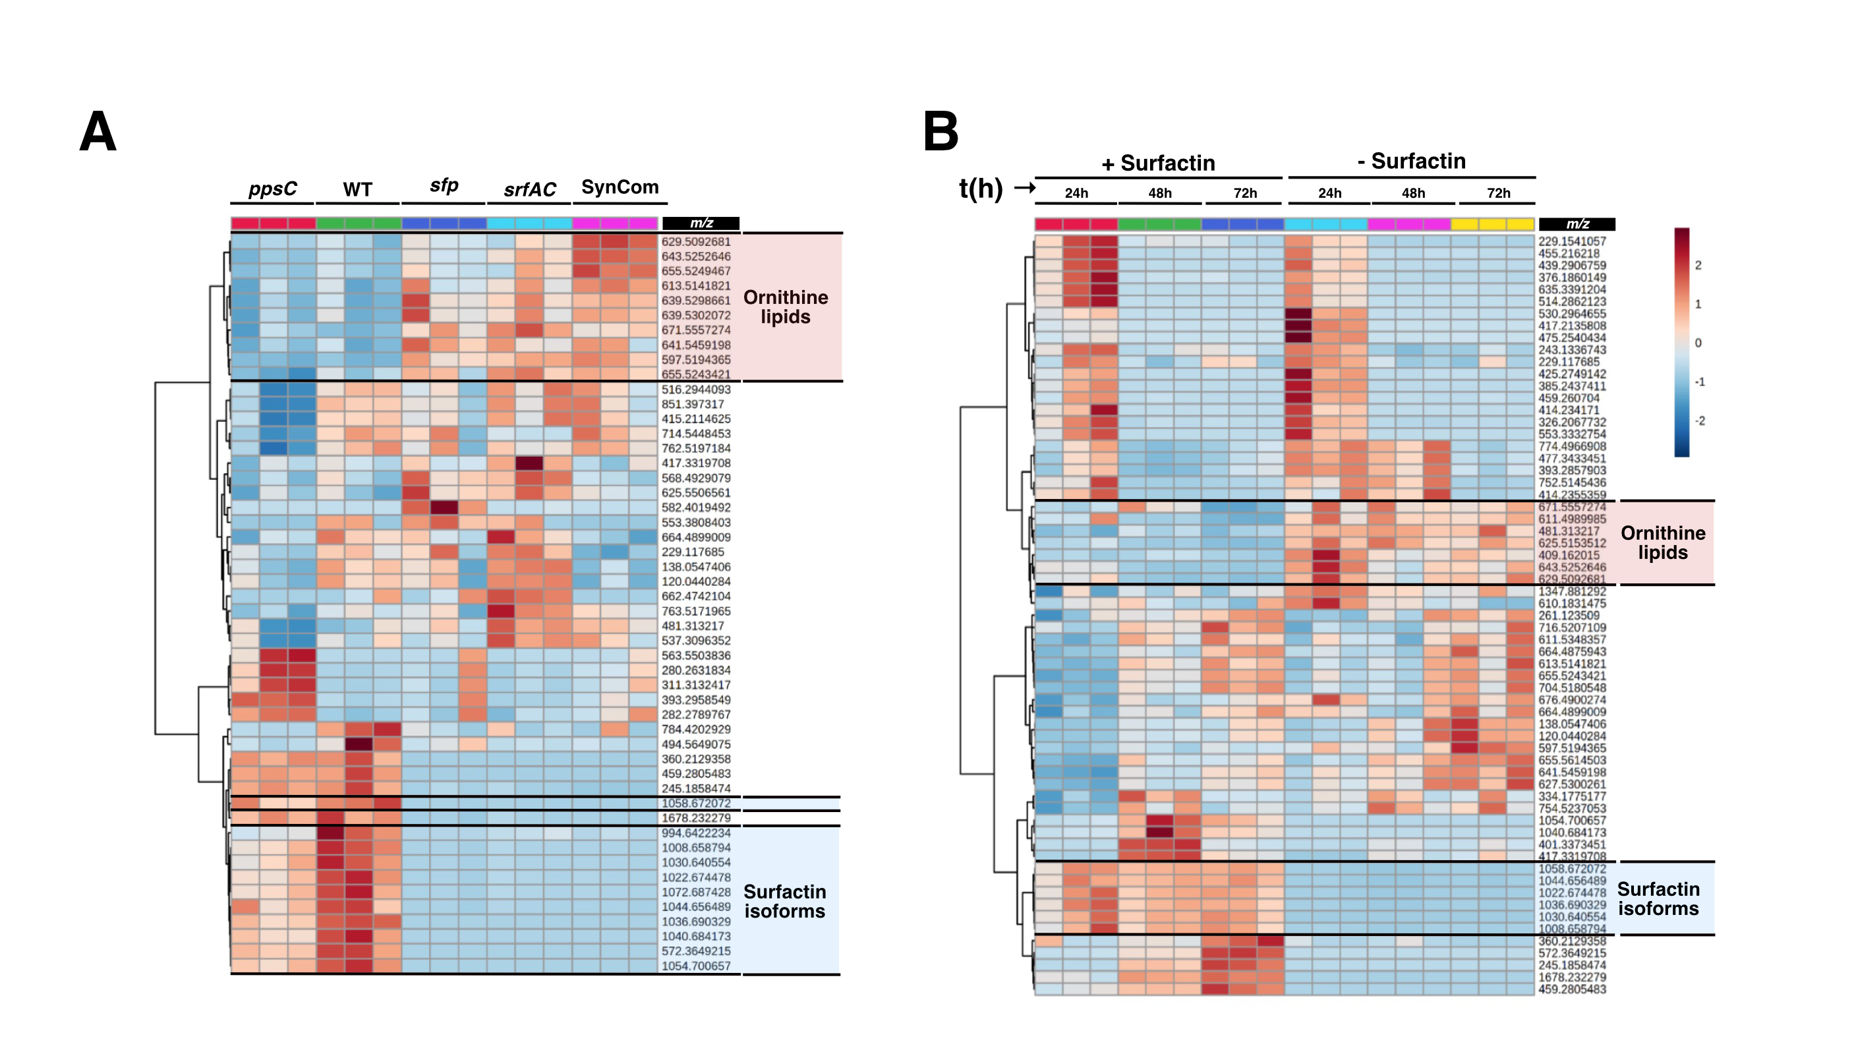
Figure 6 Untargeted metabolic analysis revealed extensive metabolic changes in the co-cultivation experiments. (A) A heatmap visualization based on the significantly more abundant chemical features (m/z) in the co-cultivation experiments. A set of chemical features (m/z), related to ornithine lipids (OLS) were strongly modulated in the presence of surfactin producer (WT and ppsC) (Upper brackets). Similarly, m/z associated with surfactin isoforms were detected in the system (Bottom brackets). (B) Changes in the SynCom chemical features when supplemented with pure surfactin. The visualization shows the variation over the time (24, 48, and 72 h) of the main chemical features produced by the SynCom. Similarly, the same group, OLS-lipids, were down-produced in the presence of pure surfactin (upper brackets). The heatmaps were made on the feature abundances retrieved from the ESI-MSI chromatogram (n=3).

Slide 7
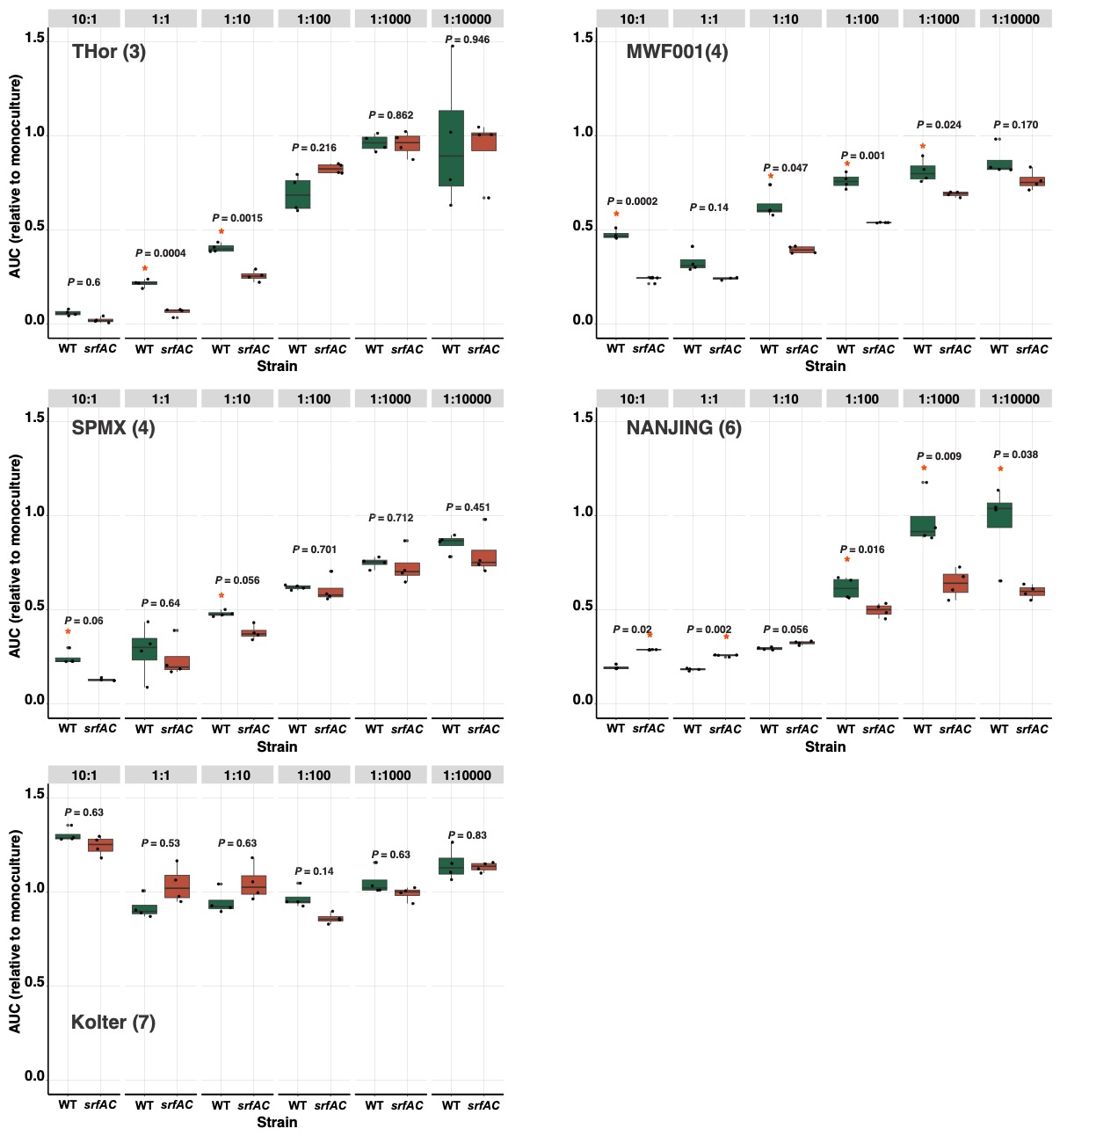
Figure 7 B. subtilis P5_B1 establishment in different publicly avalaible SynComs. The WT and its derivate mutant impaired in surfactin production (srfAC) were co-cultured with different SynCom at decreasing ratios (see Methods and SI for details). The gfp signal was used as proxy for Bacillus establishment in the co-cultures during 24h incubation period. The area under the curve (AUC) ratio (B. subtilis growth in co-culture in each SynCom dilution to B. subtilis growth in monoculture) was used as B. subtilis establishment parameter. “*” indicates that the value of the AUC ratio was significant and its position denoted which strain had a higher value (P<0.05, Student’s t-test adjusted for multiple testing by the Benjamini-Hochberg method).

Slide 8
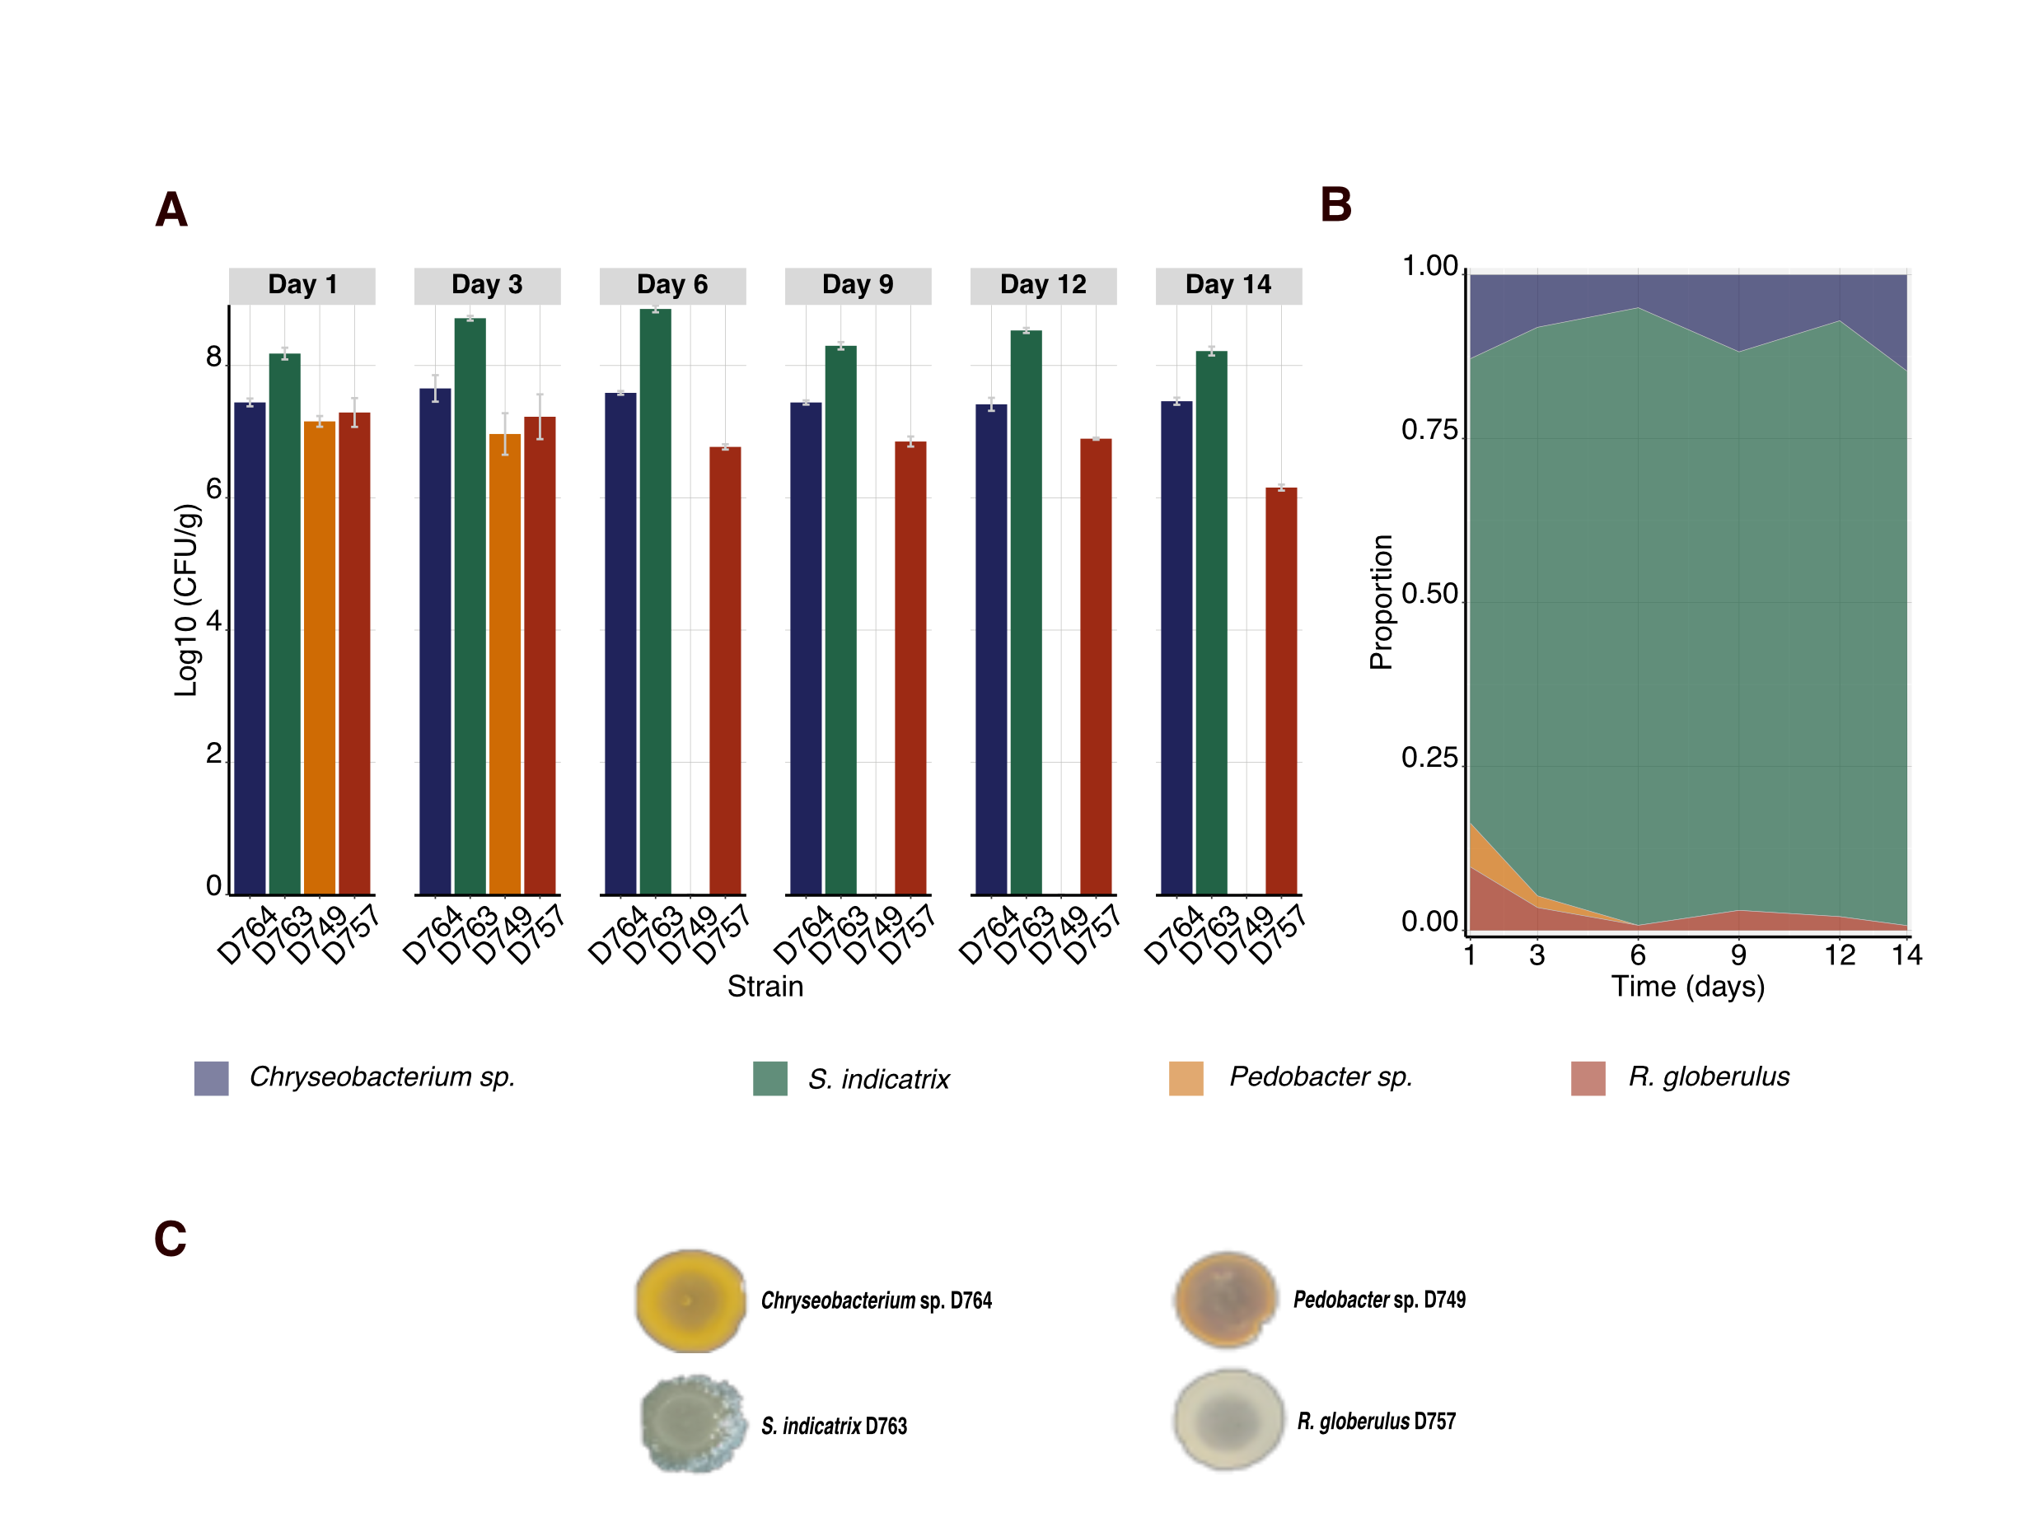
Figure S1. A stable, trackable simplified bacterial synthetic community (SynCom) for studying chemical ecology. Overnight cultures of the four members were mixed and propagated in the hydrogel matrix. The abundance of each member was differentially determined as colony-forming units per gram of beads. (A). Population dynamics of each member over time. (B) Members abundances are represented as the proportion occupied by each member related to the total biomass in the system. (C) The colony morphology of the SynCom members allows us to differentially estimate their population in co-cultures. Error bars indicate standard deviation (n=3).

Slide 9
Figure S2 Raw counts (CFU/g) of each SynCom member when challenged with the different B. subtilis variants. These raw counts were used to generate the plot showing the SynCom composition over time as the proportion occupied by each member in the Fig 2A. Each line represents a SynCom member and the point the mean and the standard deviation (n=3)

Slide 10
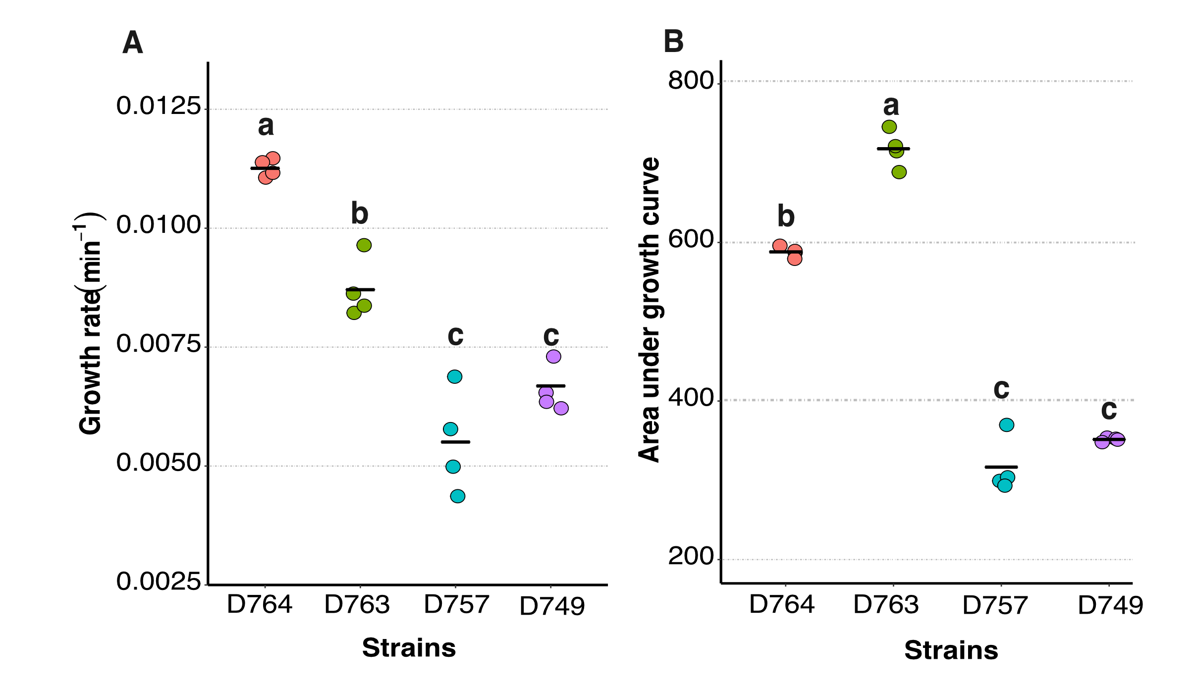
Figure S3 Growth properties of the SynCom members in liquid culture. The SynCom members were grown in 0.1 x TSB at 25C and 225 rpm for 24 h. Then, the kinetics parameters were estimaded using Growthcurver in R. Chryseobacterium sp. D764 and S. inidcatrix D763 are the fittest under this conditions as the growth rate and de AUDC revealed. (A) Growth rate of the SynCom mebers. (B) Area under growth curve as measure of strain producitivty at the end of experiment. Data were derived from four replicates. Each point represents a samples and the black bar the mean of the group. Significant diffferences were evaluated using ANOVA and the letters inidcate signifcant differences from a Tukey test (P<0.05).

Slide 11
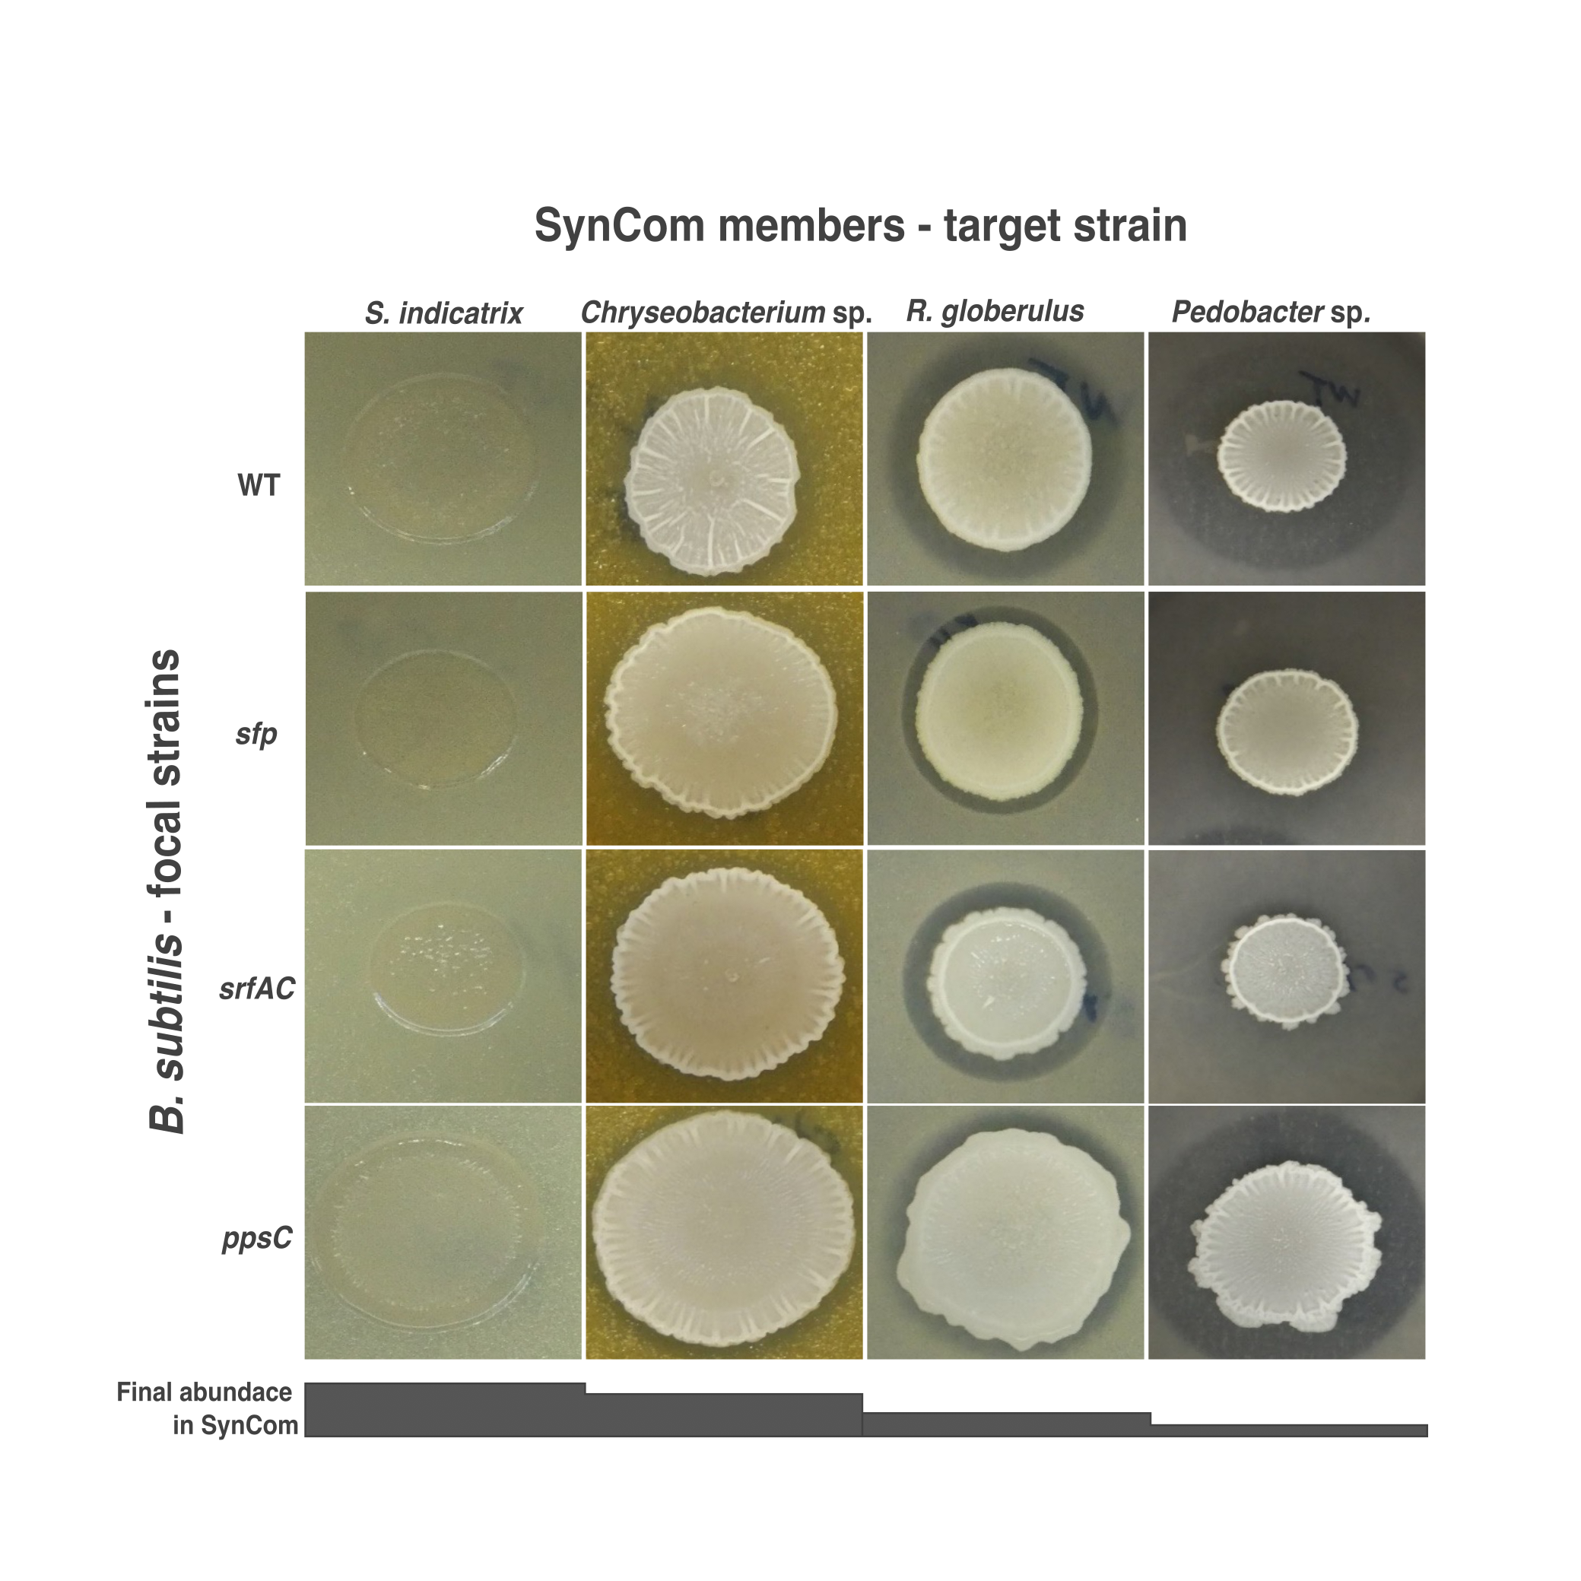
Figure S4 Antagonistic activity of B. subtilis strains against SynCom members. The SynCom members were inoculated in a soft layer of 0.1X TSA, forming a lawn. On top 5µL of each B. subtilis strain was spotted. Then, the plates were incubated and inhibition halos were recorded. The appearance of a clear halo indicates antagonistic activity.

Slide 12
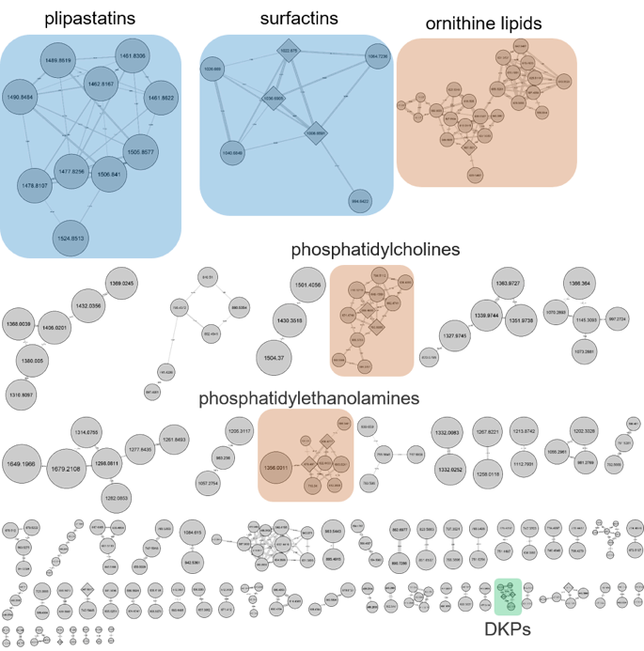
Figure S5 Feature-based molecular networking of the SynCom challenged with different variants of B. subtilis. Molecular networks of all detected features are presented in the plot. Identified chemical classes are highlighted in colors .

Slide 13
Figure S6. An overview of the differentially expressed genes of each strain over time. The number of differentially regulated genes (log2FC ≥ |2| and p-value ≤ 0.01) in each species during the co-cultivation experiment. In all the cases, the comparisons were performed as WT vs. sfp mutant.

Slide 14
Figure S7 COG categories of genes up- or down-regulated by the four species in the SynCom challenged with the WT strain if compared to sfp ones at day 5 of sampling. The COG categories names can be accessed in the following link: https://ecoliwiki.org/colipedia/index.php/Clusters_of_Orthologous_Groups_(COGs)

Slide 15
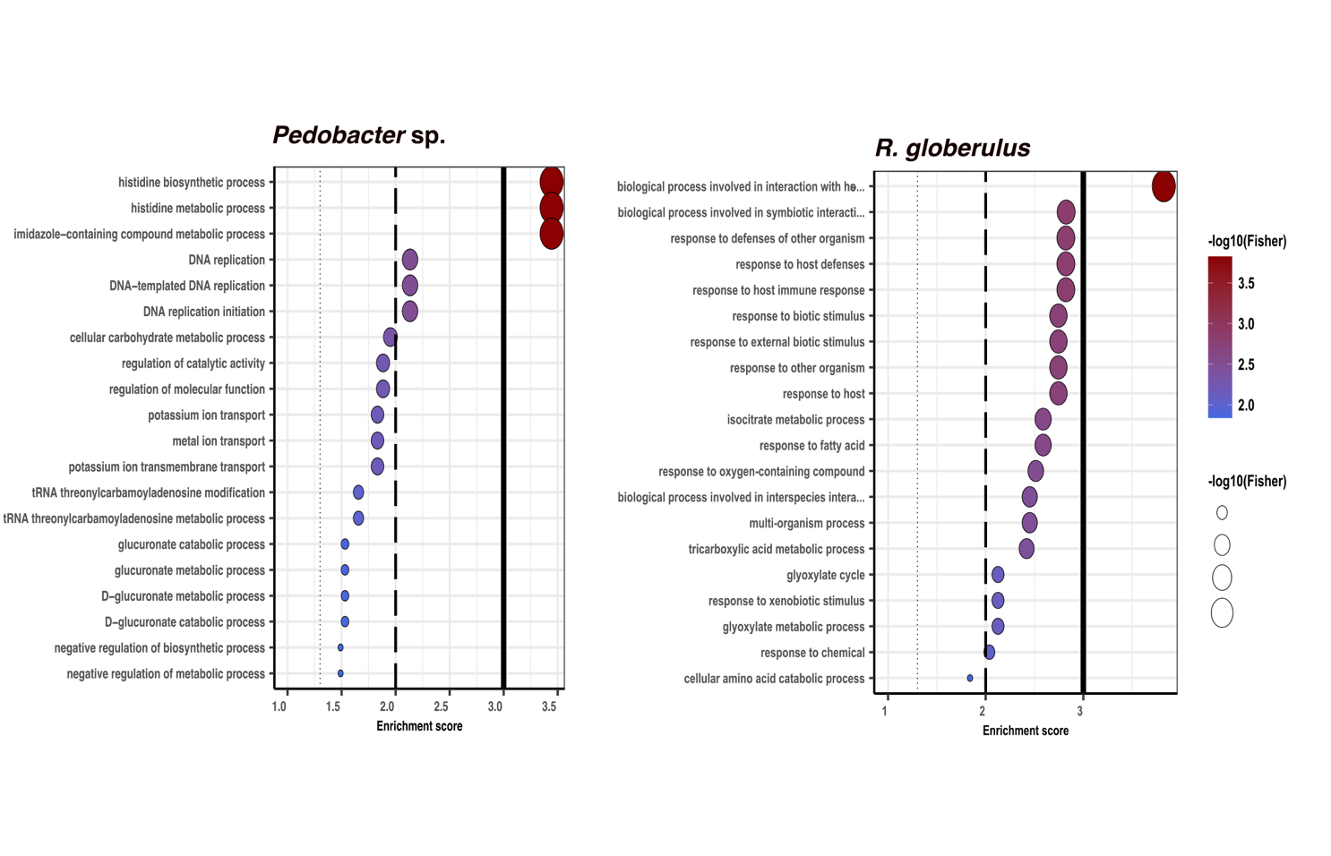
Figure S8 Biological processes in gene ontology (GO) enrichment analysis of DEGs during the B. subtilis – SynCom co-cultivation experiment. GO enrichment analysis was performed using topGO program in R. Only significantly enriched terms with corrected P < 0.05 were indicated. The color and size of each point represented the -log10 (FDR) values and enrichment scores. A higher -log10 (FDR) value and enrichment score indicated a greater degree of enrichment

Slide 16
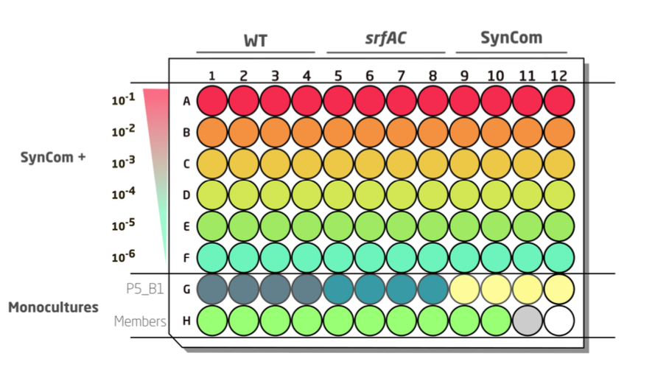
Figure S9. Microtiter plate setup for the invasion test. 200 µL of each SynCom were inoculated in the first row A. From that row, the SynCom members were 10-fold diluted by transferring 20 µL of culture to the next row containing 180 µL of medium. 6 dilution steps were made. Subsequently, 20 µL of B. subtilis the gfp-labelled variants were added to each well to conform to the co-culture. Rows G-H were dedicated to the two Bacillus strains and the individual members of each SynCom. Both Bacillus strains were cultured as a quadruplicate, and members were cultured as a quadruplicate when possible and a triplicate when not.

